Slide 1
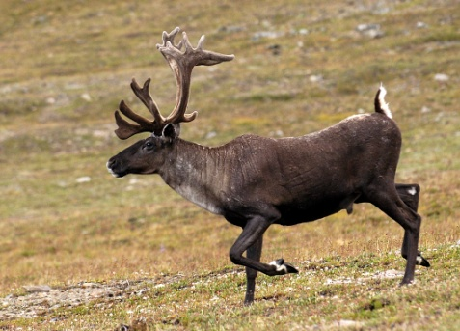
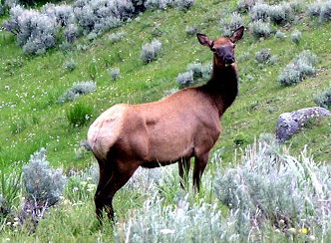



Global population dynamics and climate change: Comparing species-level impacts on two contrasting large mammals
Mark Hebblewhite^{1*}, Eric S. Post², Steven W. Running¹, Maosheng Zhao¹
¹University of Montana, ²Pennsylvania State University
Question: How does climatic influence vary across a species’ range and globally after accounting for biotic interactions?
Approach: Global Population Dynamics Approach for contrasting generalist herbivore(Post et al. 2009, Bioscience)
Methods:
Niche Modeling with climate, landuse, fire
Population dynamics models with n>120 time series with climate , vegetation indices, biotic interactions
Link population and niche models at species range scale

Slide 2


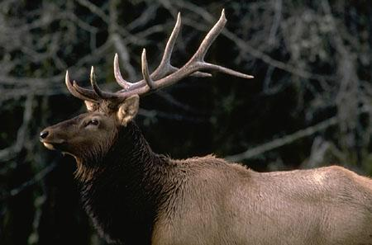
Overview
How do landuse and climatic change differentially affect the environmental niche of species throughout their ranges?
How does the strength of abiotic (climatic) factors vary across the range of an entire species distribution after accounting for biotic interactions (species interactions and resource dynamics)?
How does the spatial scale of population synchrony in Cervus vary with of climatic warming?
How do the influences of biotic and abiotic factors in dynamics vary spatially and temporally at a global scale?

Slide 3
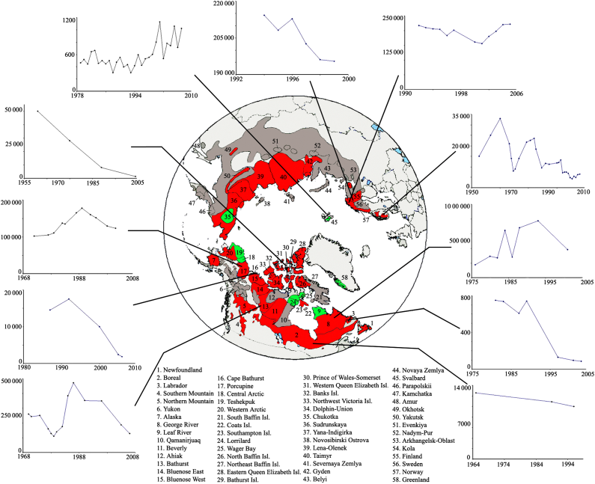
Cervus and Rangifer ecology and life history
Vors & Boyce et al. 2010

Slide 4
Cervus and Rangifer ecology and life history
Fig. 1. Correlation between population growth rate for Cervus and Rangifer populations and Northern Hemisphere temperature anomalies versus the strength of the local correlation between surface temperature and the North Atlantic Oscillation (NAO). The stronger the NAO-temperature correlation, the more local temperatures are affected by the NAO. This figure shows that the two genera will generally be affected in opposite directions by future warming. From Post et al. (2009).

Slide 5
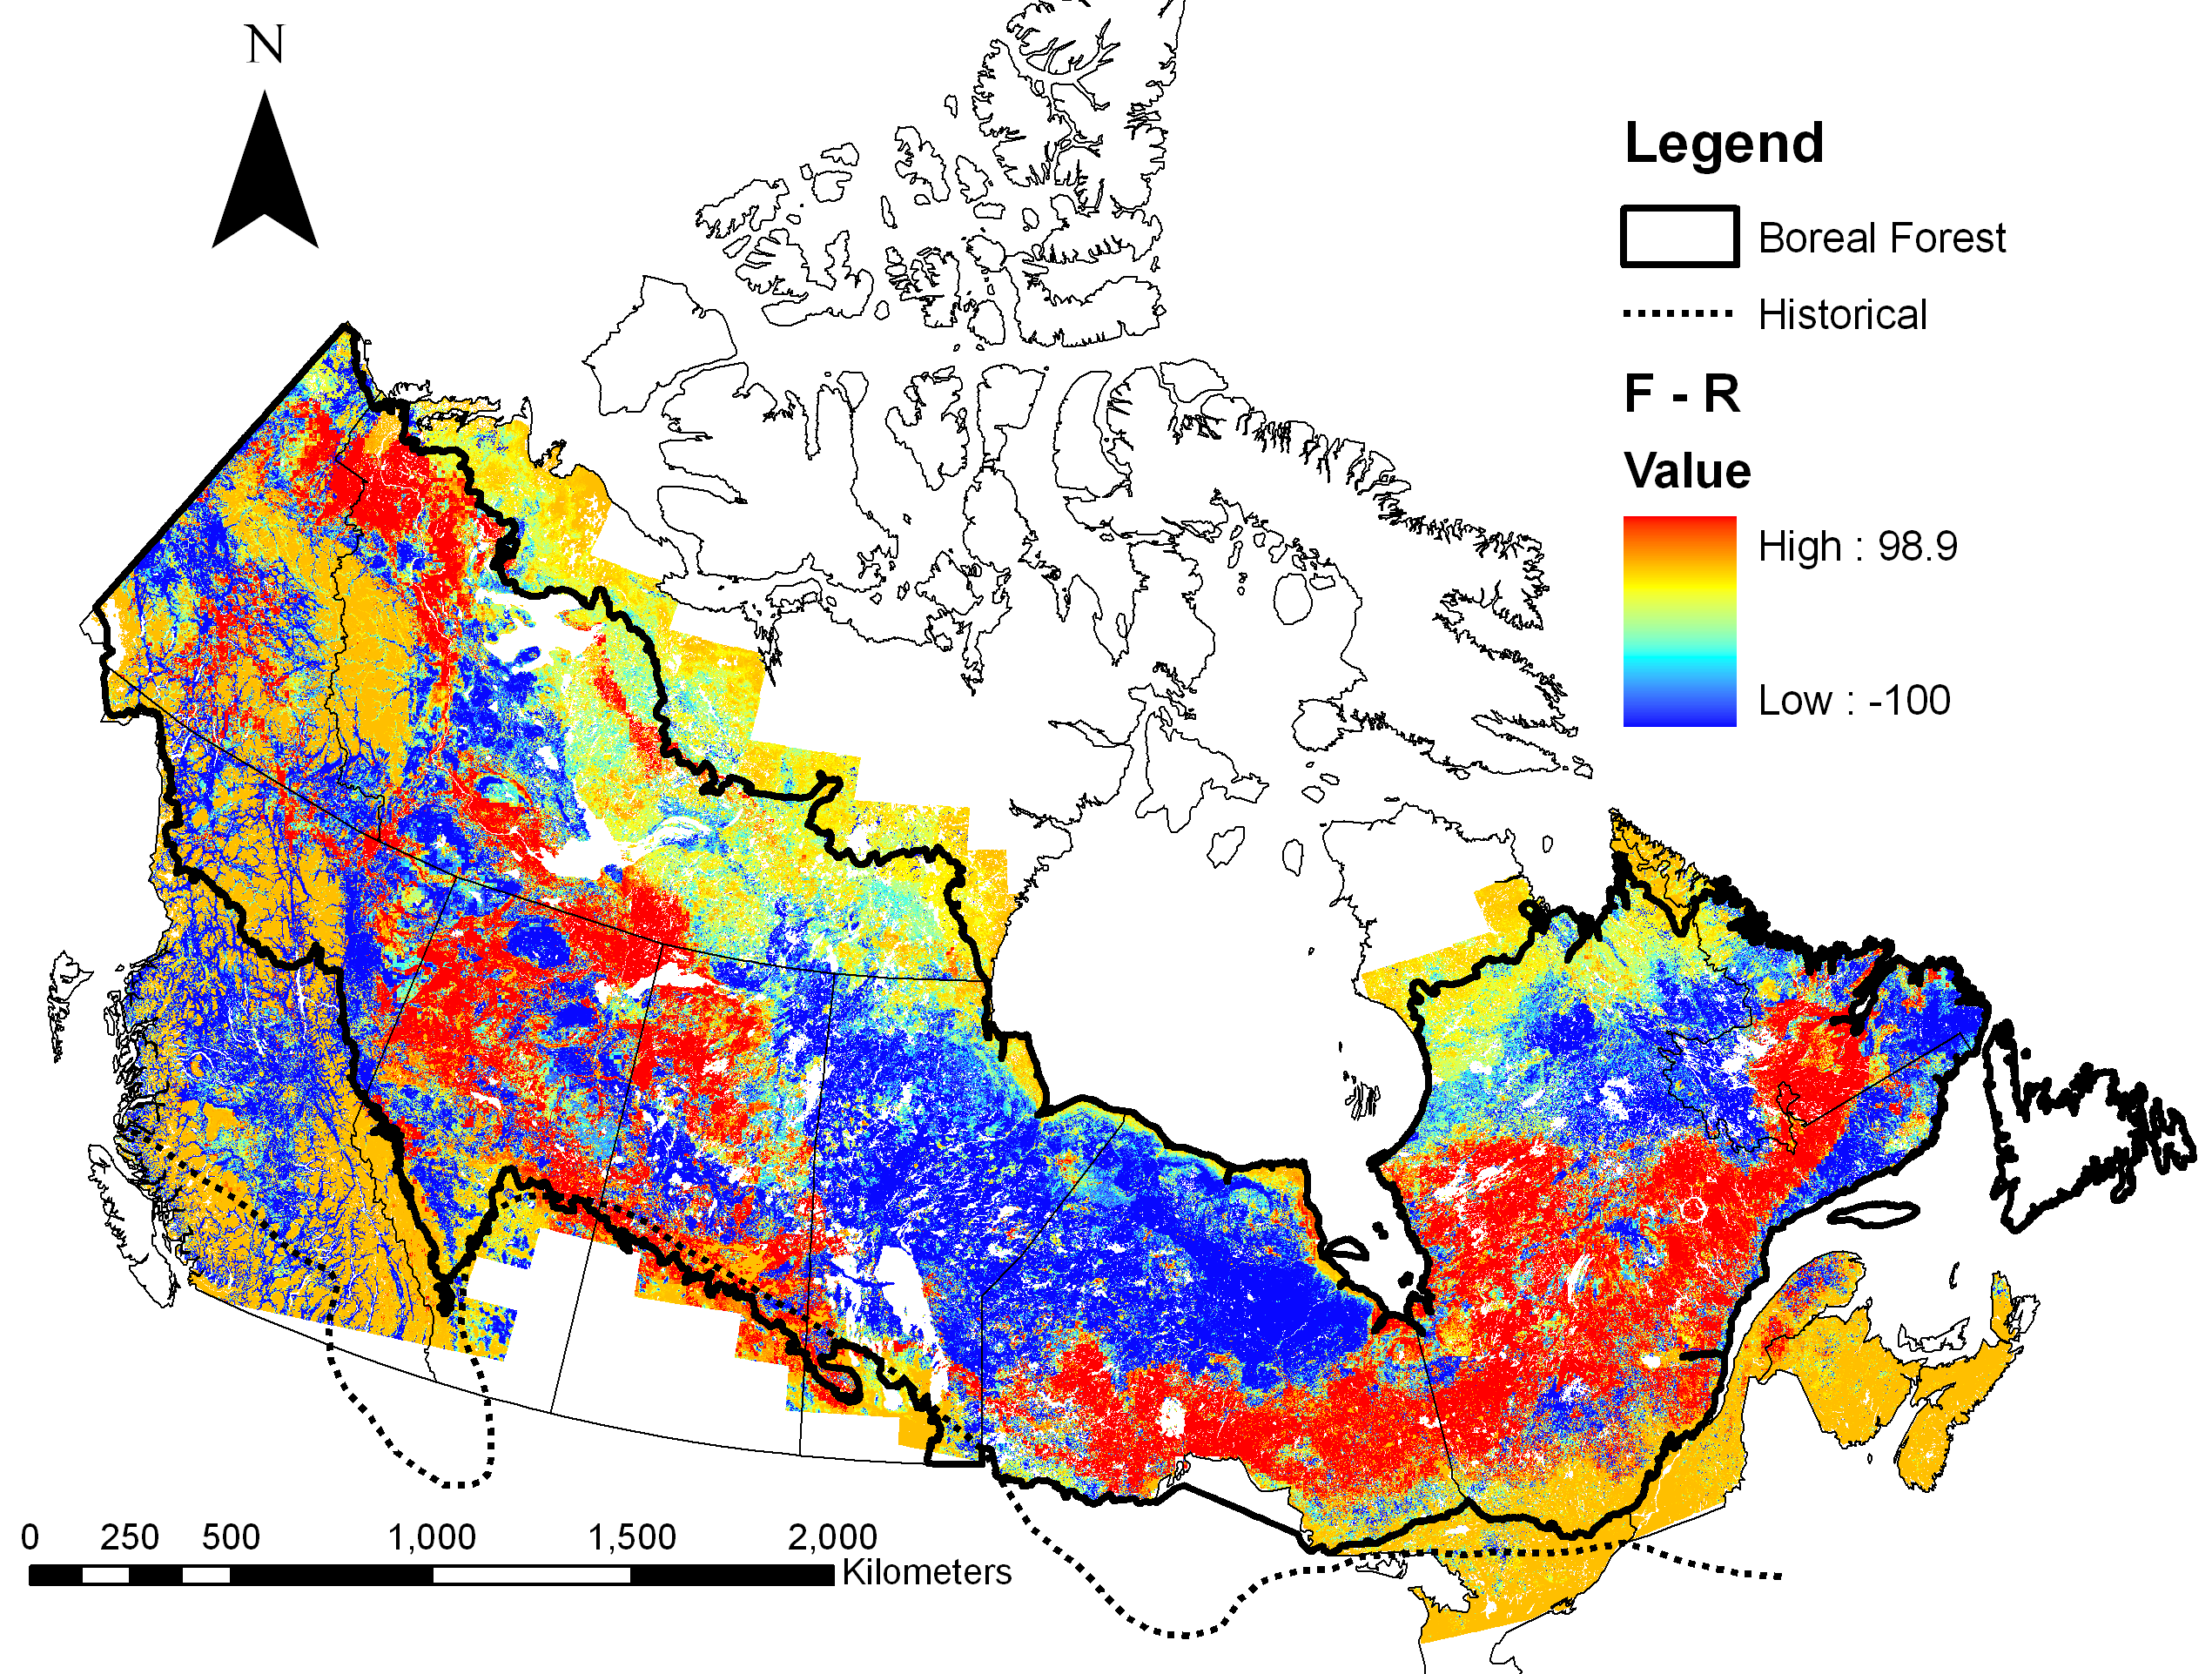
Niche Modeling

Slide 6
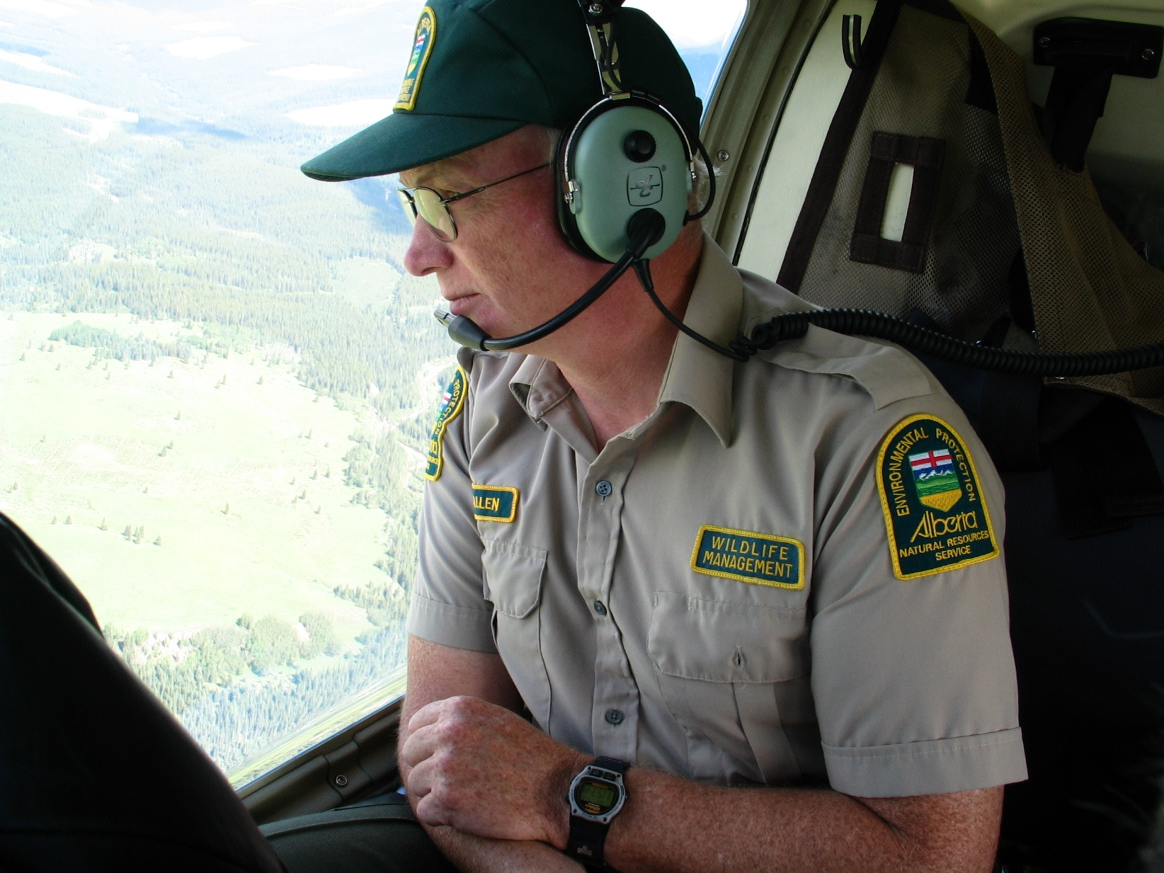
Time-Series Data

Slide 7
Time-Series Data

Slide 8
Understanding Biotic & Abiotic Drivers of Population Dynamics
Model Ungulate Population Growth Rate as a Function of Climate , Density, and Biotic Factors using Autoregressive State-Space Non-Linear Time-Series Models
N_{t} = N_{t-1}exp(β₀ + β₁X_{t-1} + Σω_{t-d}CLIM_{t-d} + ε_{t}) (1)
X_{t} = β₀ + (1 + β₁)X_{t-1} + Σω_{t-d}CLIM_{t-d} + ε_{t} (2)
X_{t} = β₀ + (1 + β₁)X_{t-1} + Σω_{t-d}CLIM_{t-d} + ρ_{τ-d}WOLF_{t-d} ε_{t} (3)

Slide 9
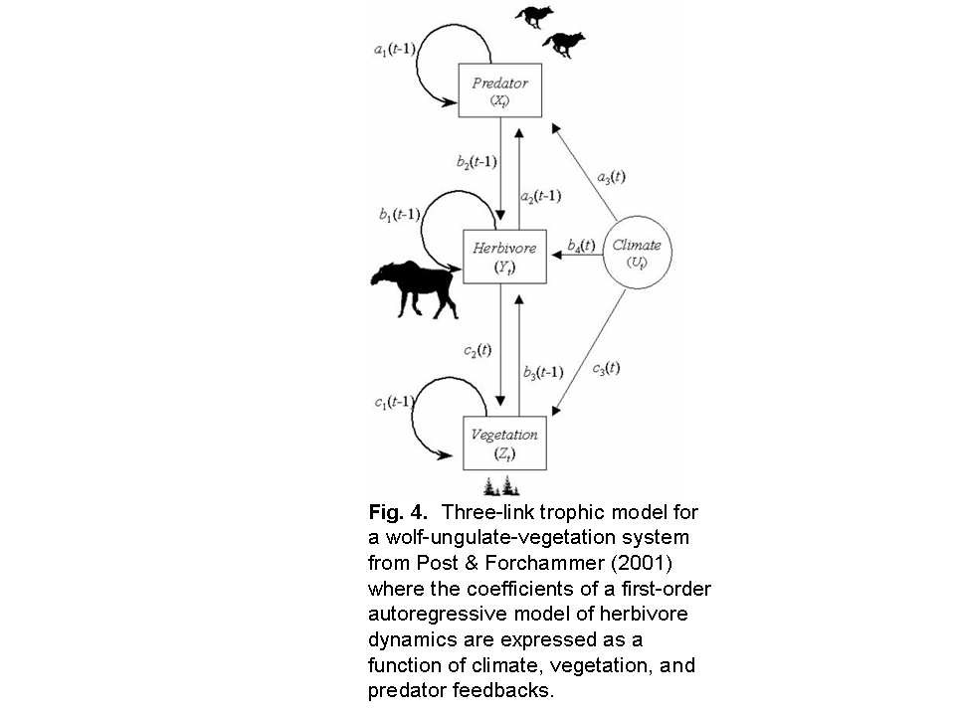
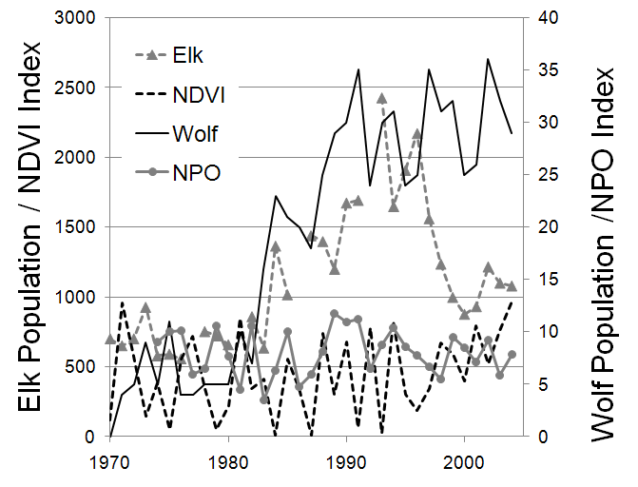
Understanding Biotic & Abiotic Drivers of Population Dynamics
Fig. 4. Three-link trophic model for a wolf-ungulate-vegetation-climate system adapted from Post & Forchmammer (2001) where the coefficients of a time-series model of herbivore dynamics are expressed as a function of climate, vegetation and predator feedbacks. At right is an example time series for Banff National Park of wolves, elk, NDVI-index (from MODIS and AVHRR), and climate (North Pacific Oscillation).

Slide 10
Time-Series Modeling
Fig. 3. Preliminary analyses showing the proportion of a subset of 94 Cervus spp. populations whose best-supported dynamics (using AICc) were described by linear density dependence (vs. “non-linear”) and responded to the NAO (“climate” vs. “no climate”).

Slide 11
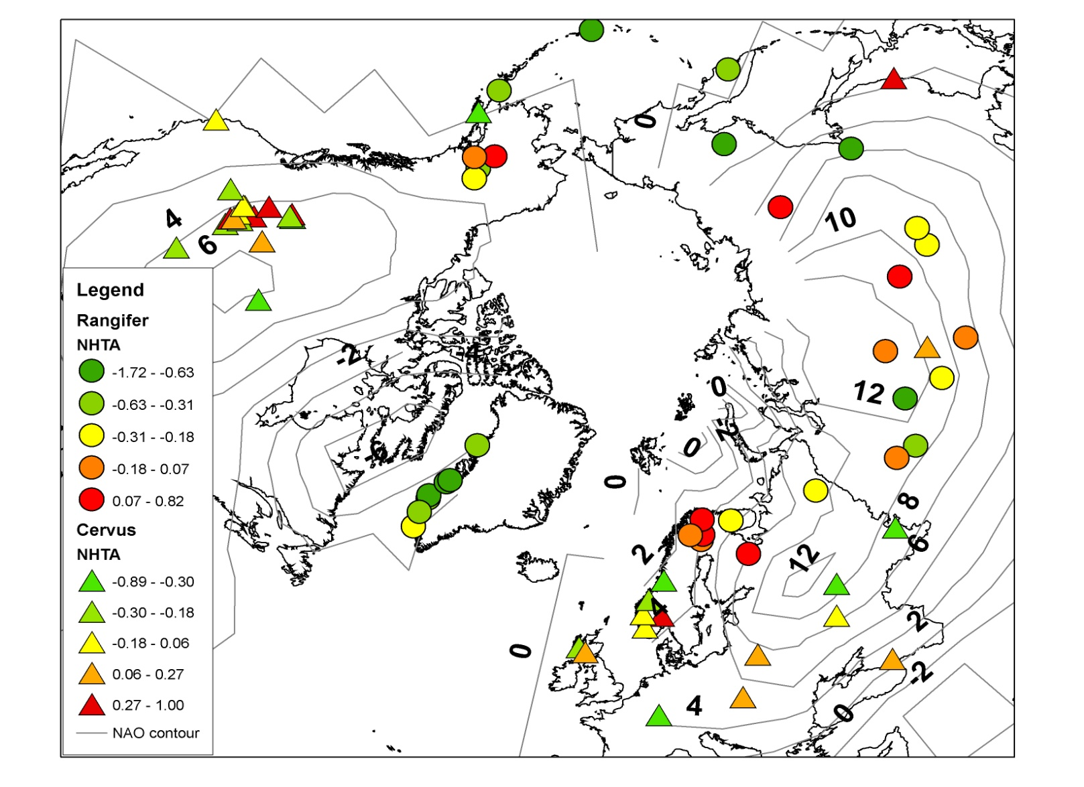
Spatial Synchrony in Population Dynamics
Fig. 6. Map of hot spots of response to climate for Cervus (triangles) and Rangifer (circles) showing the strength of and magnitude (green – negative, red – positive) of the correlation with Northern Hemisphere temperature anomalies (NHTA) and population growth rate. The strength of the relationship between local temperature and a +1 standard deviation (SD) change in the North Atlantic Oscillation (NAO) is shown in the contour bands; a +10 correlation indicates a 1 degree Celsius change in local temperature with a +1 SD change in NAO. From Post et al. (2009).

Slide 12
Population-Weighted Niche Model

Slide 13
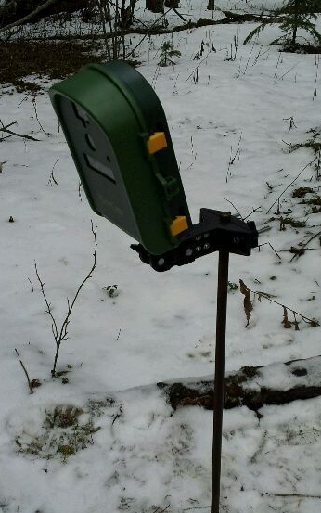
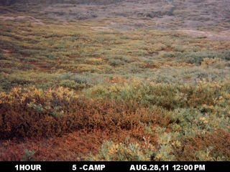
Understanding NDVI-Forage relationships
What does NDVI (& other VI’s) mean for Ungulate energetics?
Key underlying driver of ungulate response to climate change
Forage for ungulate is biomass, quantity and spatio-temporal variation
Measure with combined ground-based remote plant cameras, plant forage sampling & remote sensing
Idaho to Greenland latitudinal gradient
Collaborators: Jeff Kerby (PSU), Greg McDermid (Uof Calgary)

Slide 14
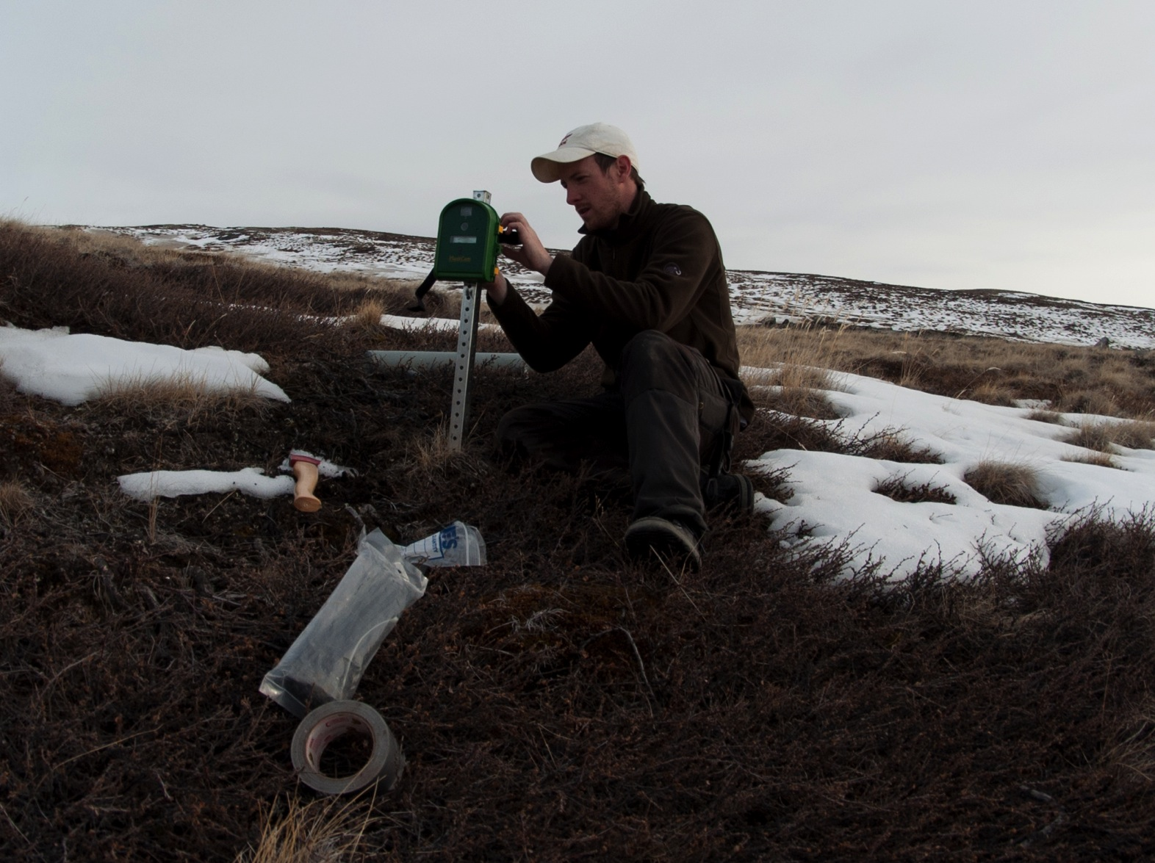
Understanding NDVI-Forage relationships

Slide 15
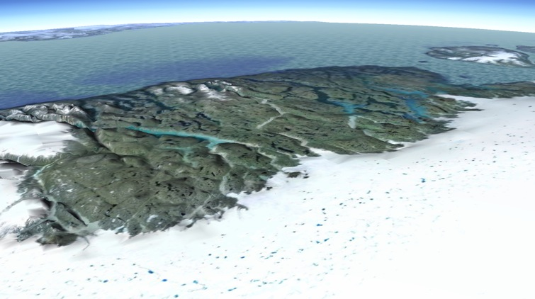
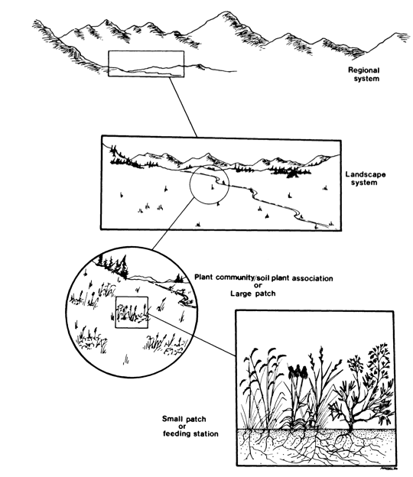
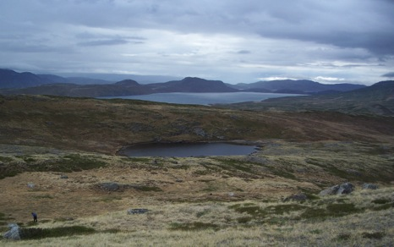
An Ecological Hierarchy
Senft et al. 1987

Slide 16
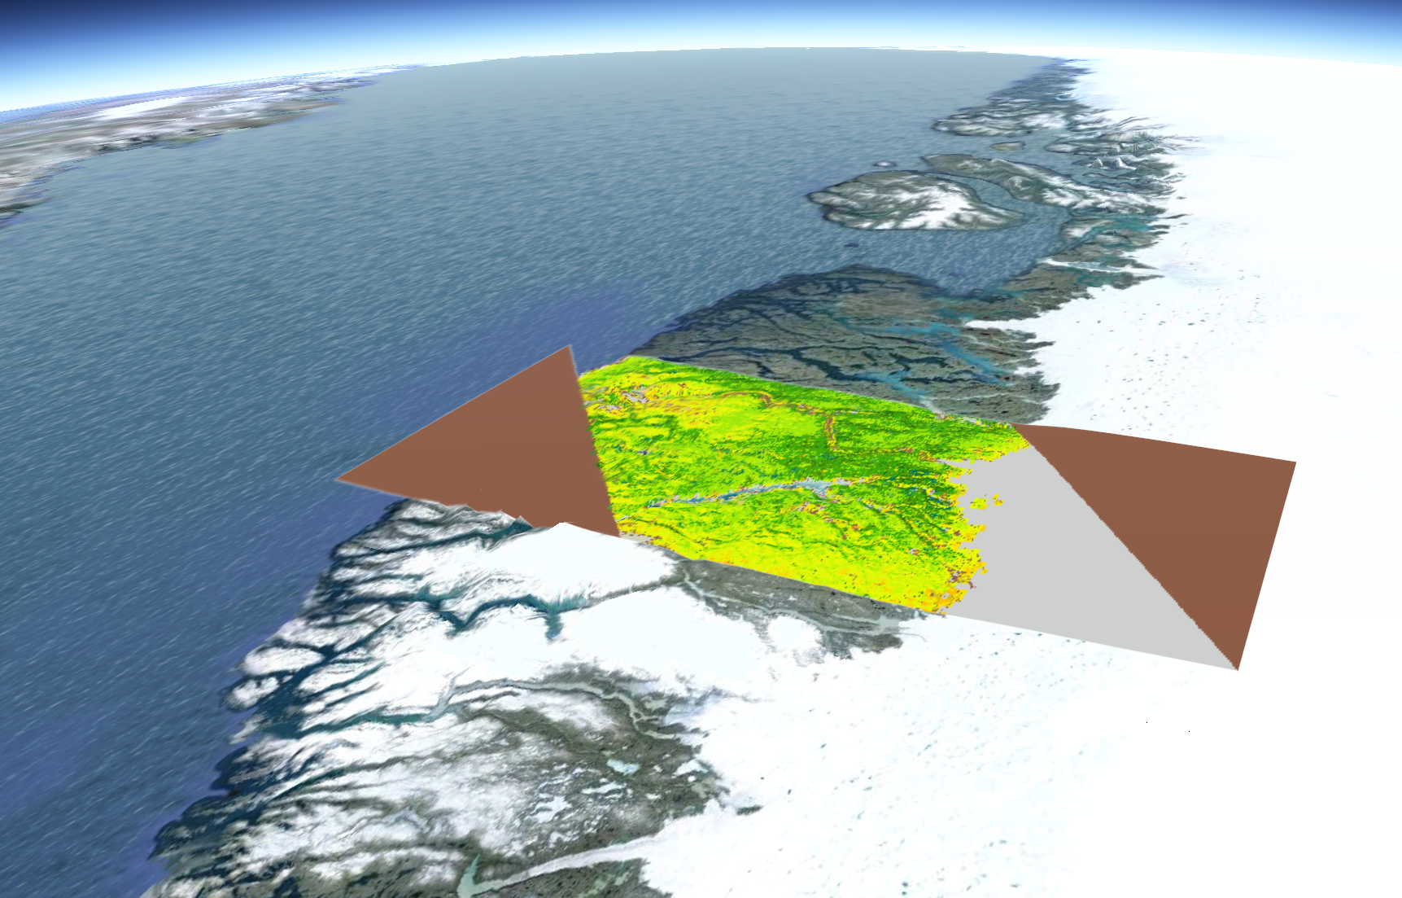
MODIS + Landcover + DEM

Slide 17
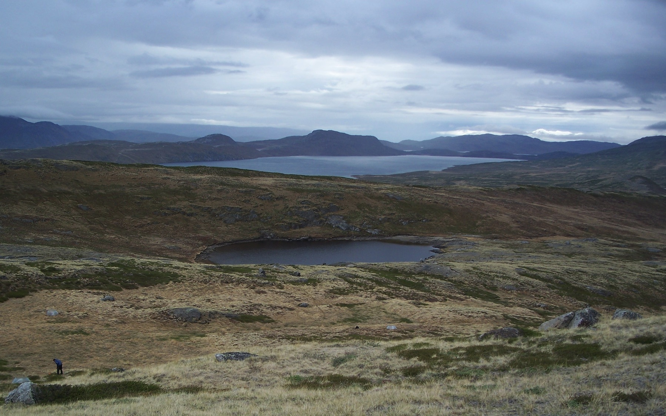
Point and Shoot Camera (CHDK Hack?)

Slide 18
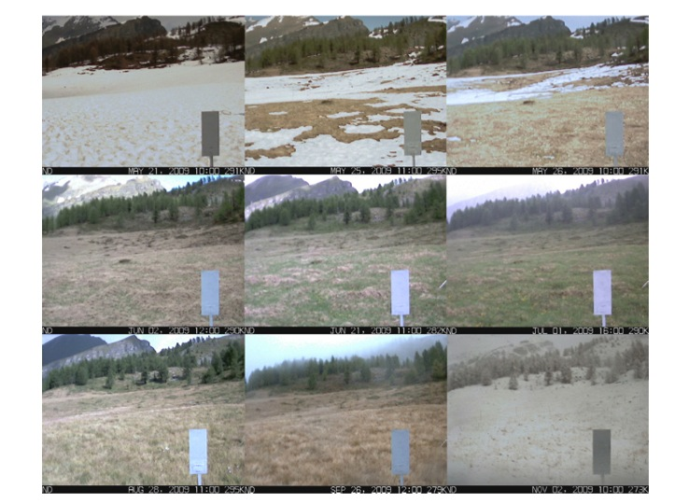
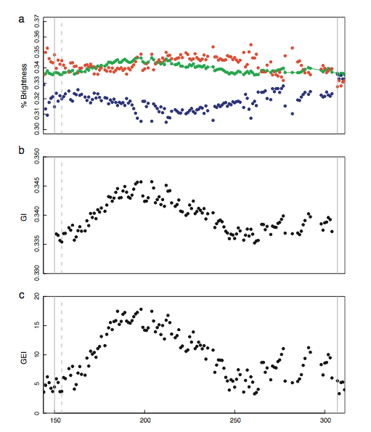
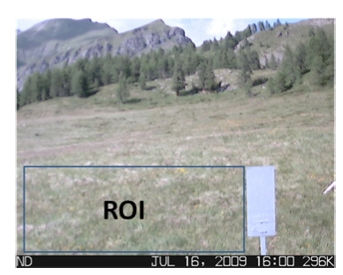
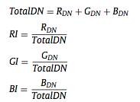
Alpine Grassland
Migliavacca et al. 2011

Slide 19
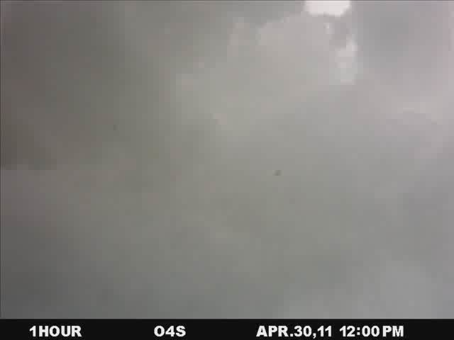
Understanding NDVI-Forage relationships

Slide 20
Progress Update
Ungulate time-series acquisition (Hebblewhite, Post)
Ungulate niche modeling for woodland caribou, data-acquisition for barrenground (Hebblewhite)
NDVI/VI data acquisition for time-series (M. Zhao, Running)
Forage-NDVI relationship sampling summer 2011 (Post, Hebblewhite)

Slide 21
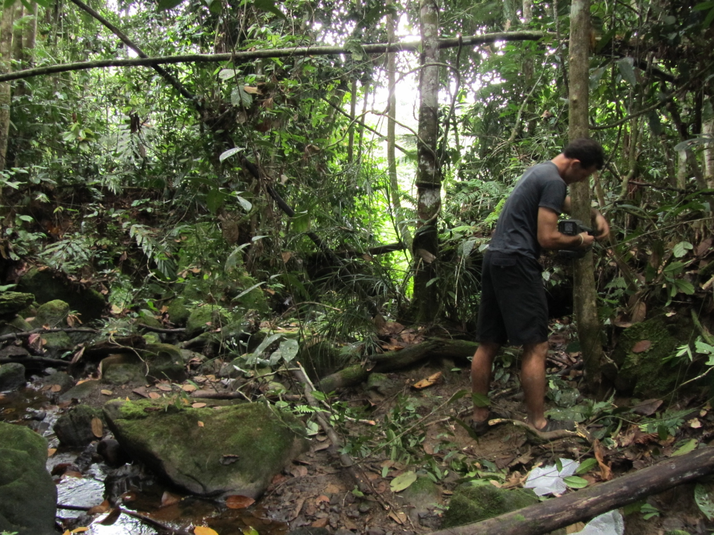
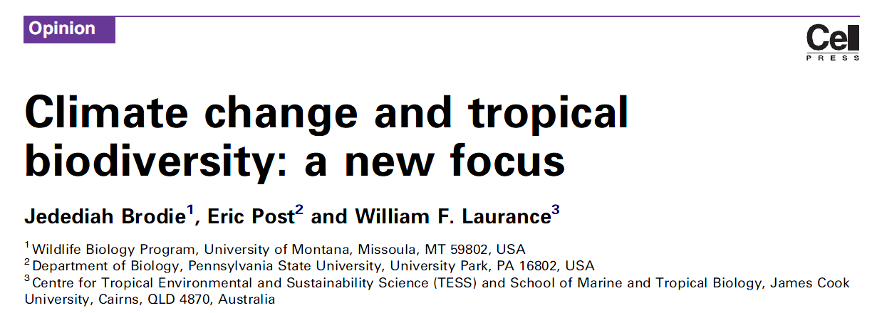
Biodiversity Monitoring Thoughts…

Slide 22
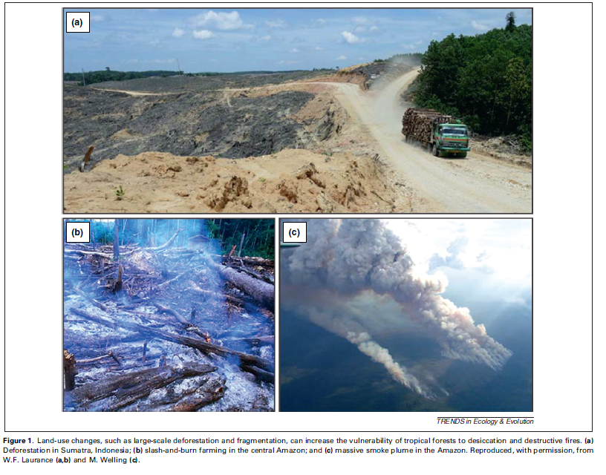
Tropical Climate Change & Land Use Change

Slide 23
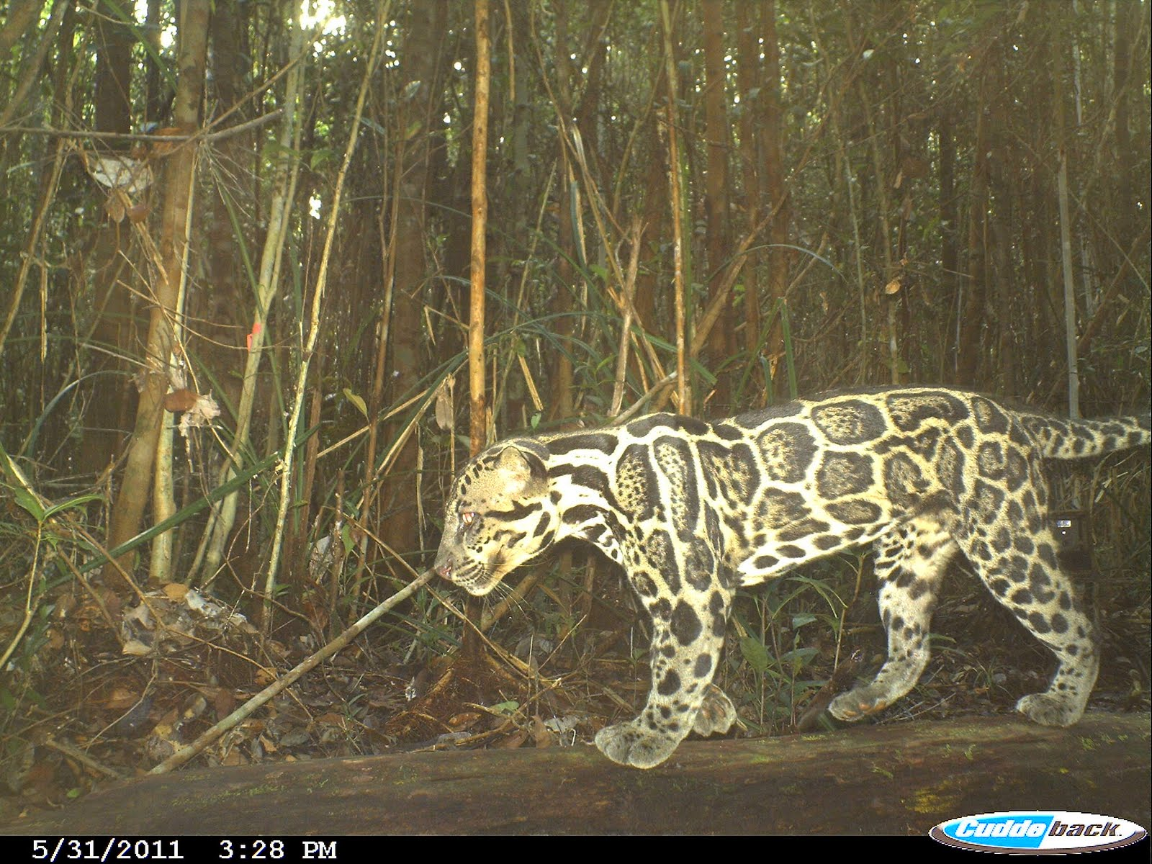
Biodiversity Monitoring Thoughts…

Slide 24
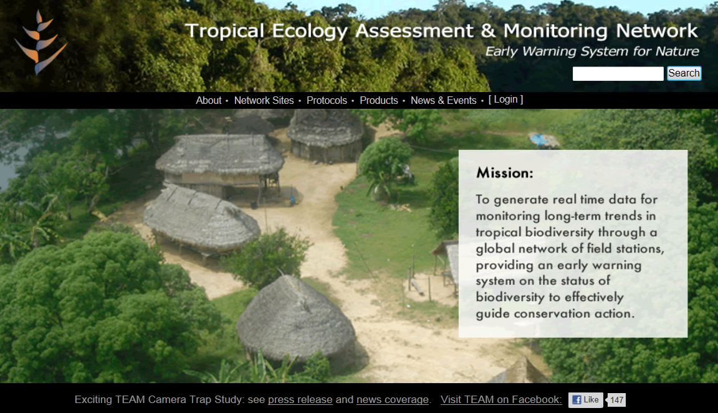
TEAM: Tropical Ecosystem Assesment & Monitoring Network
http://www.teamnetwork.org/

Slide 25
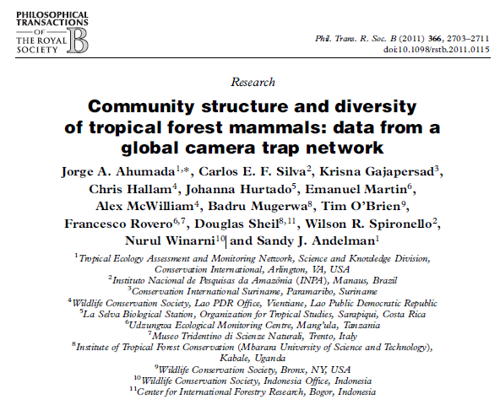
TEAM: Tropical Ecosystem Assesment & Monitoring Network
http://www.teamnetwork.org/

